Slide 1
Fake News
Presented By:
Madbouly – Nagy – Helmy – Samir
Supervised By:
Eng. Sayed
Dr. Doaa

Slide 2
Introduction
Company’s Decision Making.
Rule of Data Science and Big Data.
Our project.
Machine Learning
Data Science Workflow
Data Gathering
Data Preprocessing
Model Creation, Training and Testing

Slide 3
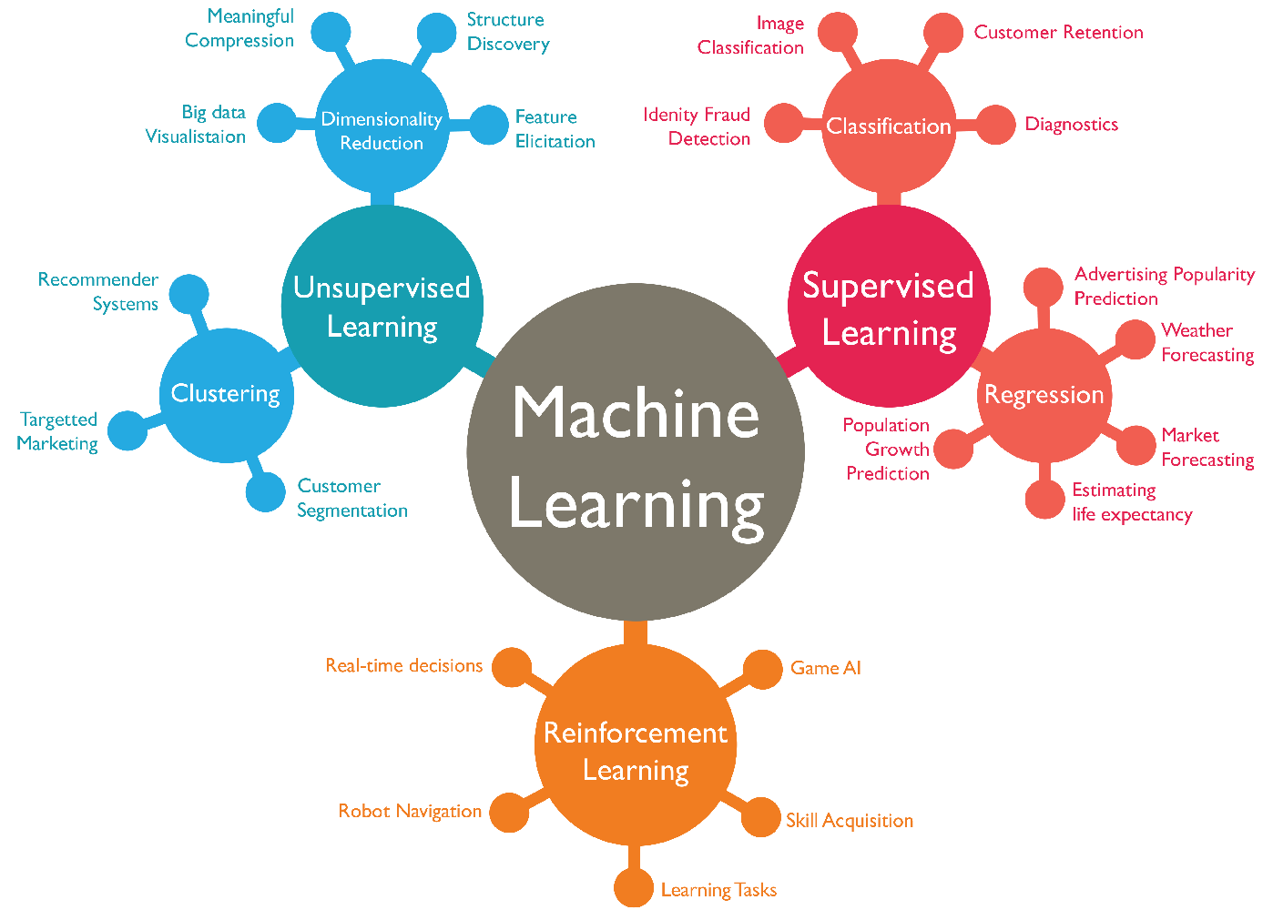
Machine Learning

Slide 4
Data Science Workflow
Data Gathering.
Data Preprocessing.
Modeling Creation, Training and Testing.

Slide 5
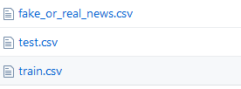
Data Gathering
We rely on a Kaggle dataset as a base.
Title: The title of an article
Text: The body of the article
Label: which only have the name of the class

Slide 6
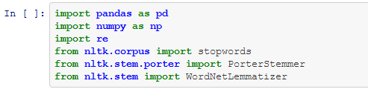
Data Preprocessing

Slide 7
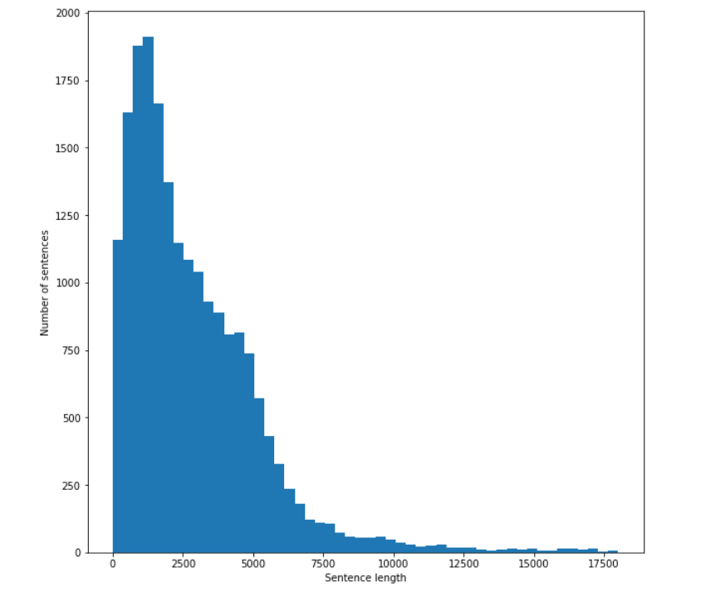
Data Preprocessing Con.

Slide 8
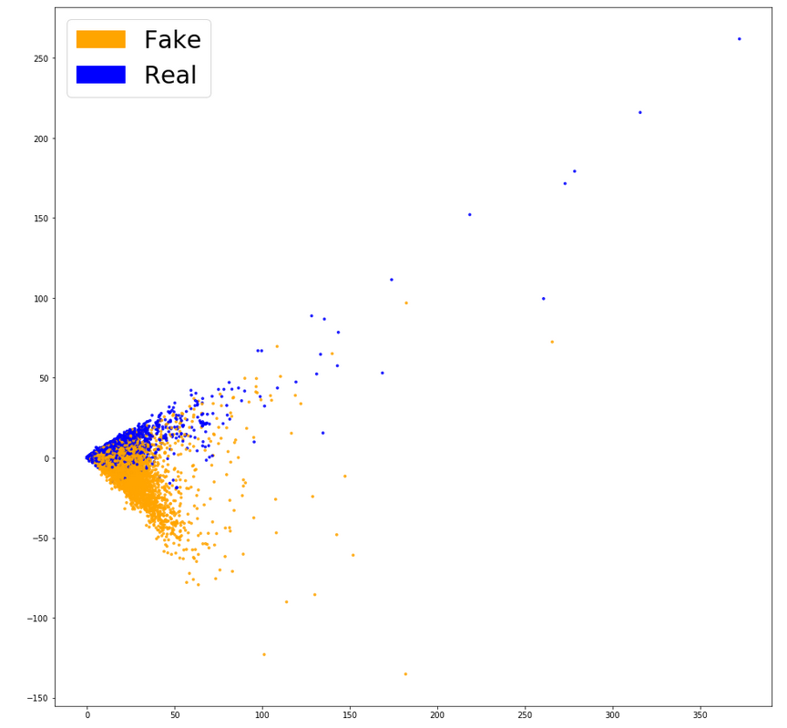
Data Preprocessing Con.

Slide 9
Model Creation, Training and Testing
Term Frequency-Inverse Document Frequency (TF_IDF)
Random Forest Classifier
Logistic Regression

Slide 10
Implementation
# To-do

